Slide 1
COMP 3220
Rodrigo Sardinas

Slide 2
How do I win?
Start Early on Assignments!
Review the PPT (study notes)
“Come to Class” (at least watch the videos)

Slide 3
Class and Office Hours
Virtual Classroom via Zoom
T/R 2 pm – 3:15 pm (3220-002)
https://auburn.zoom.us/j/94811031814
T/R 3:30 pm – 4:45 pm (3220-001)
https://auburn.zoom.us/j/97924680593
Virtual Office Hours
M/W 1 pm – 2 pm
https://auburn.zoom.us/j/92551015100
Weekly/Monthly Meetup Outside of Regular Classroom Hours?

Slide 4
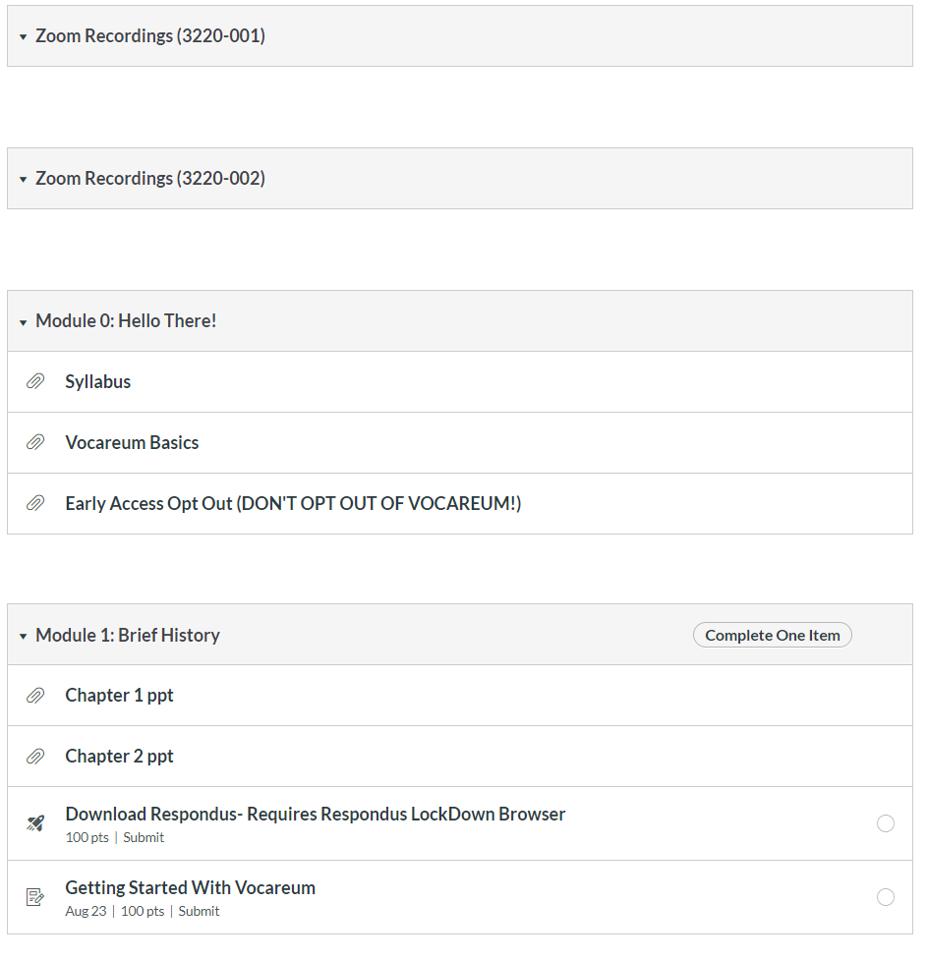
Calendar
In Canvas

Slide 5
Grading
Pop-Quiz | 10% | Grading Scale A 90 – 100% B 80 – 89% C 70 – 79% D 60 – 69% F <60%
Assignments | 40%
Mid-term | 25%
Final | 25%

Slide 6
Grading Categories
Pop Quizzes
Due Midnight
Timed
Available Day-of
Usually on Thursdays
Vocareum
Coding with immediate feedback
Applying what is learned in class
Usually 1 – 2 weeks

Slide 7
Grading Categories
Midterm/Final
Cumulative
Multiple Choice
Book Material Only
Must complete during scheduled time

